Slide 1
Introduction to Physical Layer

Slide 2
Outline
SIGNALS – data , signals both analog and digital
SIGNAL IMPAIRMENT – transmission and performance of network
DIGITAL TRANSMISSION – analog and digital data to digital signal
TRANSMISSION MEDIA – guided(wires and cables) and unguided(air)

Slide 3
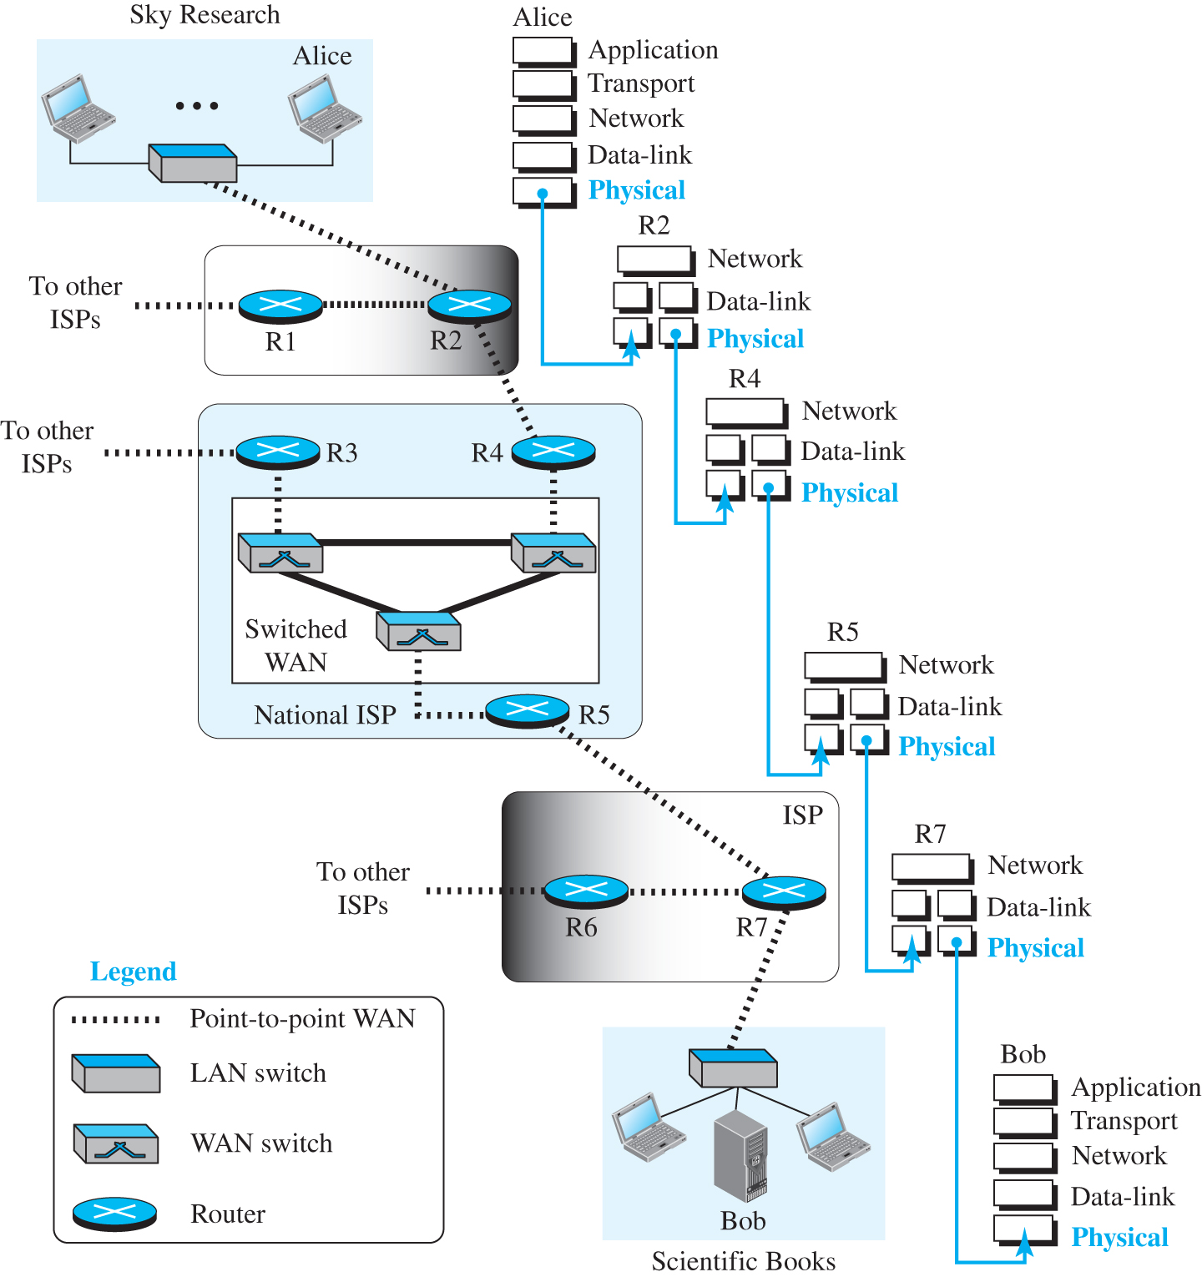
Figure:- Communication at the physical layer : A scenario where a scientist Alice working at sky research needs to order a book for her research from bob, the manager of scientific books, an online bookstore
SIGNALS

Slide 4
2-1 SIGNALS
The communication between Alice and Bob is depicted using a network topology and a data flow diagram.
Two host devices (one belongs to Alice) are connected to a LAN switch.
This network represents sky research. The LAN switch connects to a router R2 by point-to-point WAN.
The R2 connects to a router R4 through a by point-to-point WAN, that in turn connects to a WAN switch belonging to a switched WAN network of three WAN devices.

Slide 5
2-1 SIGNALS
The third WAN switch from the switched network connects to a router R5 by point-to-point WAN. This network represents a national ISP.
The router R5 connects to a router R7 in an ISP network.
The router R7 connects to a LAN switch belonging to a network representing scientific books.
The LAN switch connects to two host devices and a mainframe represents Bob.

Slide 6
2-1 SIGNALS
The data flow diagram shows that the data flows from the physical layer of Alice host device to the physical layer of R2 which has two physical and data-link layers and a network layer.
From the other physical layer, the data flows to the physical layer of R4.
From the other physical layer of R4, the data flows to the physical layer of R5.
Likewise, the data flows from R5 to R7 and reaches the physical layer of the Bob host device.

Slide 7
SIGNALS
What is exchanged between Alice and Bob is data, but what goes through the network at the physical layer is signals.

Slide 8
Analog and Digital Data
Data can be analog or digital.
The term analog data refers to information that is continuous
digital data refers to information that has discrete states.
For example, an analog clock that has hour, minute, and second hands gives information in a continuous form; the movements of the hands are continuous.
On the other hand, a digital clock that reports the hours and the minutes will change suddenly from 8:05 to 8:06.

Slide 9
Analog Signal
An analog signal can take one of the two forms: periodic or aperiodic.
A periodic signal completes a pattern within a measurable time frame, called a period, and repeats that pattern over subsequent identical periods.
The completion of one full pattern is called a cycle.
A nonperiodic signal changes without exhibiting a pattern or cycle that repeats over time
In data communication, normally periodic analog signals and nonperiodic digital signals are used

Slide 10
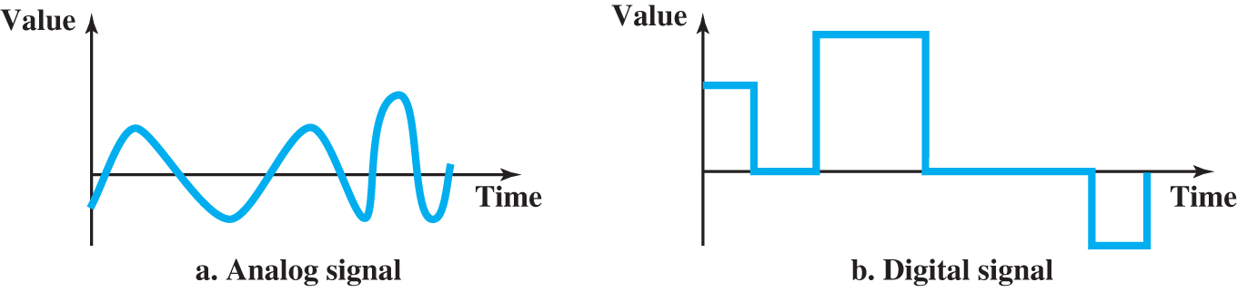
SIGNALS
Signals can be either analog or digital.
An analog signal has infinitely many levels of intensity over a period of time.
As the wave moves from value A to value B, it passes through and includes an infinite number of values along its path.
A digital signal, on the other hand, can have only a limited number of defined values.
Although each value can be any number, it is often as simple as 1 and 0.

Slide 11
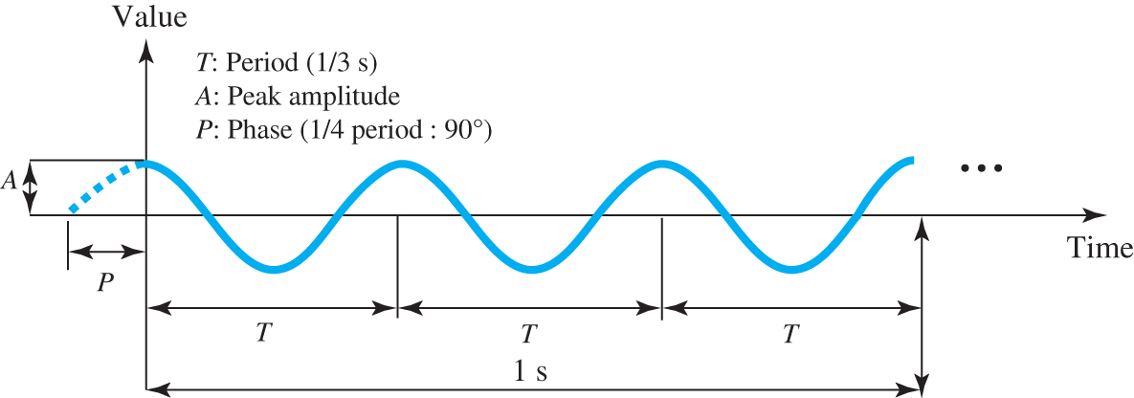
Analog Signal

Slide 12
Analog Signal
Periodic analog signals can be classified as simple or composite.
A simple periodic analog signal, a sine wave, cannot be decomposed into simpler signals.
A composite periodic analog signal is composed of multiple sine waves.
The sine wave is the most fundamental form of a periodic analog signal.
Figure in the next slide shows a sine wave

Slide 13
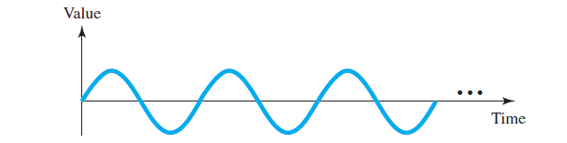
Analog Signal
A sine wave can be represented by three parameters: the peak amplitude, the frequency, and the phase.
These three parameters fully describe a sine wave.

Slide 14
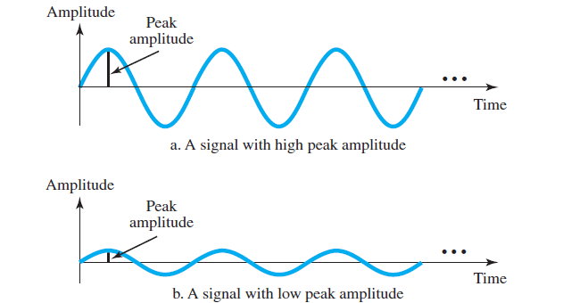
Analog Signal
Peak Amplitude
The peak amplitude of a signal is the absolute value of its highest intensity.
Figure below shows two signals and their peak amplitudes.

Slide 15
Analog Signal
Period and Frequency
The period (T) refers to the amount of time, in seconds, that a signal needs to complete one cycle.
The frequency (f), measured in Hertz (Hz), refers to the number of periods in one second.
Period and frequency are inverse of each other, in other words.
f = 1/ T

Slide 16
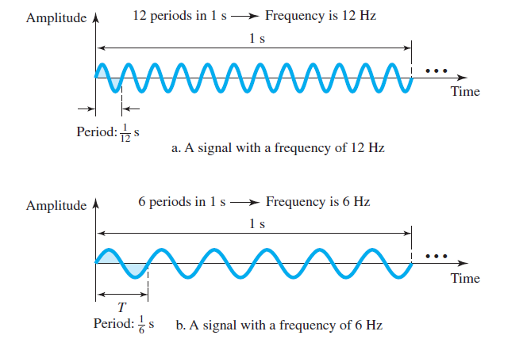
Analog Signal

Slide 17
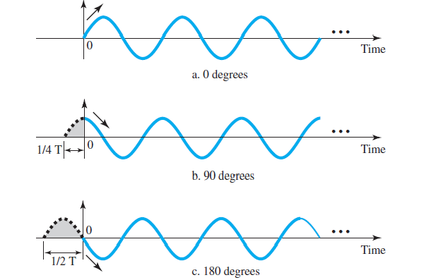
Analog Signal
The term phase, or phase shift, describes the position of the waveform relative to time 0.
Phase is measured in degrees or radians

Slide 18
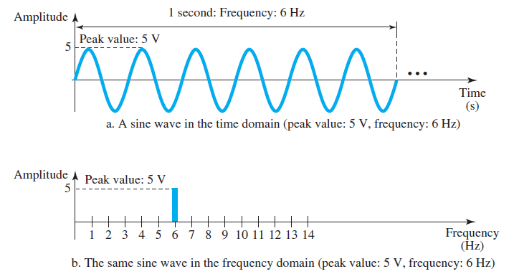
Analog Signal
Time and Frequency Domain
A sine waves is comprehensively defined by its amplitude, frequency, and phase.
This can be done in both time and frequency domain.
A complete sine wave in the time domain can be represented by one single spike in the frequency domain.

Slide 19
Analog Signal
Composite Signal
A composite signal is made of many simple sine waves.
A single-frequency sine wave is not useful in data communications
A composite signal is needed in data communication.
Bandwidth
The range of frequencies contained in a composite signal is its bandwidth.
The bandwidth of a signal is the difference between the lowest and highest frequencies in the signal.

Slide 20
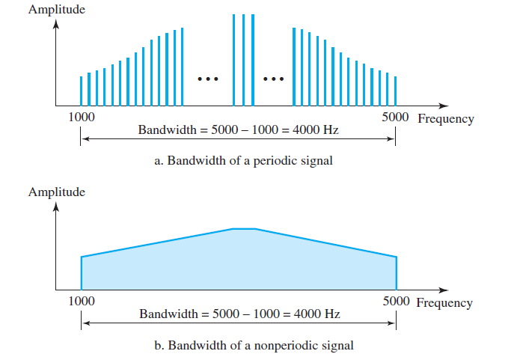
Analog Signal
For example, if a composite signal contains frequencies between 1000 and 5000, its bandwidth is 5000 − 1000, or 4000.

Slide 21
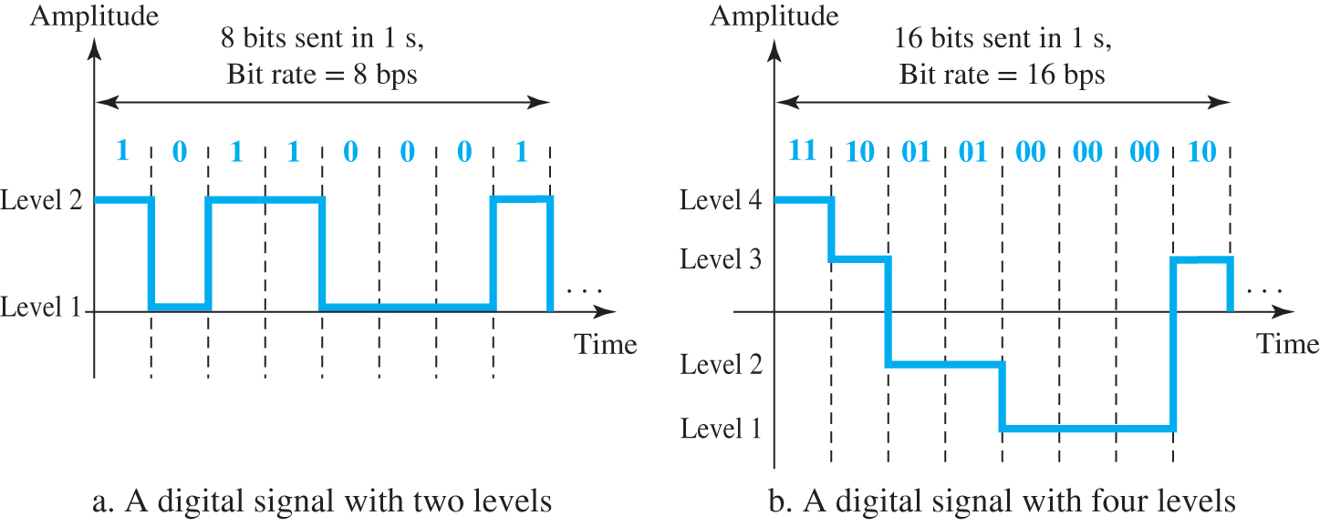
Digital Signal
Information can also be represented by a digital signal.
For example, a value 1 can be encoded as a positive voltage and a value 0 as zero voltage.
A digital signal can have more than two levels. In this case, we can send more than 1 bit for each level.

Slide 22
Digital Signal
In general, if a signal has L levels, each level needs log₂ L bits.
For this reason, we can send log₂4 = 2 bits in part b.
Bit Rate
Most digital signals are nonperiodic, and thus period and frequency are not appropriate characteristics.
Another term-bit rate (instead of frequency) is used.
The bit rate is the number of bits sent in 1 second.
Example- Assume we have downloaded text documentation at the rate of 100 pages per minute. A page is an average of 24 lines with 80 characters per line. If we assume that one character requires 8 bits, the bit rate is:
100 * 24 * 80 * 8 = 1,536,000 bps = 1.536 Mbps

Slide 23
Digital Signal
Bit Length
The bit length is the distance one bit occupy on the transmission medium.
Bit length = propagation speed X bit duration

Slide 24
Digital Signal
Transmission of Digital Signal
A digital signal is a composite analog signal with frequencies between zero and infinity.
We can have two types of transmission: baseband and broadband.
Baseband Transmission
means sending the digital signal without changing it to analog signal.
Broadband Transmission
means changing the digital signal to analog signal and send the analog signal.

Slide 25
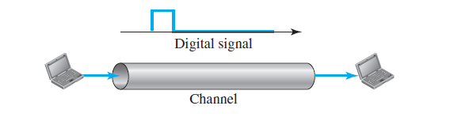
Baseband Transmission
Baseband transmission means sending a digital signal over a channel without changing the digital signal to an analog signal.
Figure below shows baseband transmission.

Slide 26
Baseband Transmission
Baseband transmission requires that we have a low-pass channel, a channel with a bandwidth that starts from zero.
This is the case if we have a dedicated medium with a bandwidth constituting only one channel.
For example, the entire bandwidth of a cable connecting two computers is one single channel.
As another example, we may connect several computers to a bus, but not allow more than two stations to communicate at a time.

Slide 27
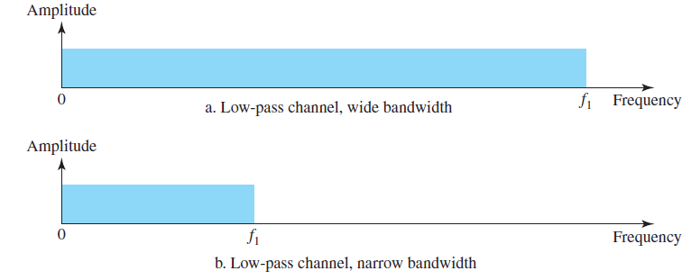
Baseband Transmission
Figure below shows two low-pass channels: one with a narrow bandwidth and the other with a wide bandwidth.

Slide 28
Case 1: Low-Pass Channel with Wide Bandwidth
To preserve the exact form of a nonperiodic digital signal with vertical segments vertical and horizontal segments horizontal, we need to send the entire spectrum, the continuous range of frequencies between zero and infinity
This is possible if we have a dedicated medium with an infinite bandwidth between the sender and receiver that preserves the exact amplitude of each component of the composite signal.
Although this may be possible inside a computer (e.g., between CPU and memory), it is not possible between two devices.

Slide 29
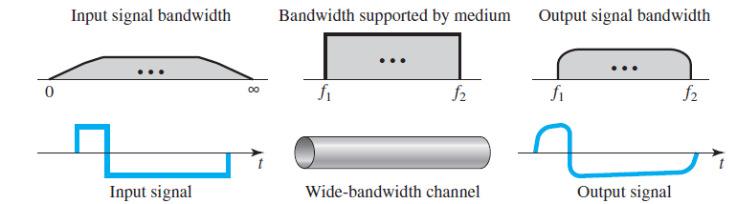
Case 1: Low-Pass Channel with Wide Bandwidth
if we have a medium, such as a coaxial or fibre optic cable, with a very wide bandwidth, two stations can communicate by using digital signals with very good accuracy, as shown in Figure below

Slide 30
Case 1: Low-Pass Channel with Wide Bandwidth
Although the output signal is not an exact replica of the original signal, the data can still be deduced from the received signal.
Baseband transmission of a digital signal that preserves the shape of the digital signal is possible only if we have a low-pass channel with an infinite or very wide bandwidth.
An example of a dedicated channel where the entire bandwidth of the medium is used as one single channel is a LAN.

Slide 31
Case 1: Low-Pass Channel with Wide Bandwidth
In a bus topology LAN with multipoint connections, only two stations can communicate with each other at each moment in time (timesharing); the other stations need to refrain from sending data.
In a star topology LAN, the entire channel between each station and the hub is used for communication between these two entities.

Slide 32
Case 2: Low-Pass Channel with Limited Bandwidth
In a low-pass channel with limited bandwidth, we approximate the digital signal with an analog signal.
The level of approximation depends on the bandwidth available.
In baseband transmission, the required bandwidth is proportional to the bit rate.
if we need to send bits faster, we need more bandwidth.

Slide 33
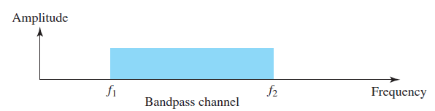
Broadband Transmission (Using Modulation)
Broadband transmission or modulation means changing the digital signal to an analog signal for transmission.
Modulation allows us to use a bandpass channel—a channel
with a bandwidth that does not start from zero.

Slide 34
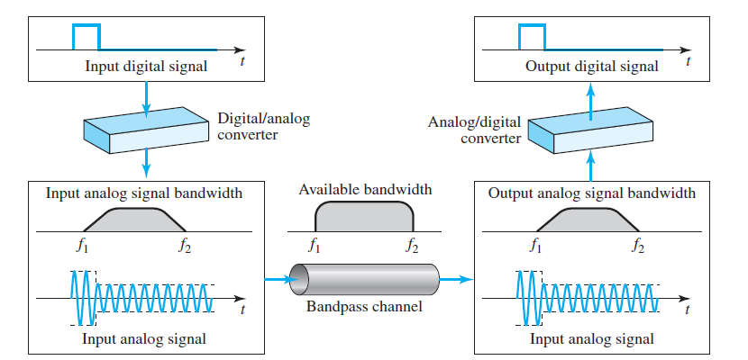
Modulation of a digital signal

Slide 35
Examples
An example of broadband transmission using modulation is the sending of computer data through a telephone subscriber line, the line connecting a resident to the central telephone office.
A second example is the digital cellular telephone.

Slide 36
SIGNAL IMPAIRMENT
Signals travel through transmission media, which are not perfect.
The imperfection causes signal impairment.
This means that the signal at the beginning of the medium is not the same as the signal at the end of the medium.
“What is sent is not what is received”.
Three causes of impairment are attenuation, distortion, and noise.

Slide 37
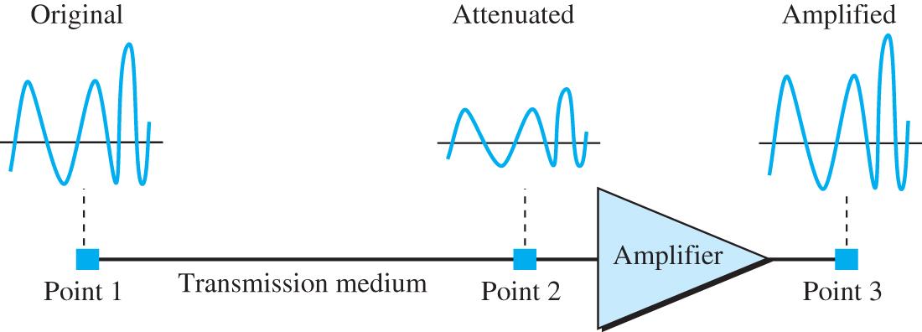
Attenuation and Amplification
SIGNAL IMPAIRMENT
Attenuation means a loss of energy.
To compensate for this loss we need amplification.
When a signal, simple or composite, travels through a medium, it loses some of its energy in overcoming the resistance of the medium.

Slide 38
Decibel
To show that a signal has lost or gained strength, engineers use the unit of the decibel.
The decibel (dB) measures the relative strengths of two signals or one signal at two different points.
Note that the decibel is negative if a signal is attenuated and positive if a signal is amplified.
dB=10 log₁₀ P2/P1
Variables P1 and P2 are the powers of a signal at points 1 and 2, respectively.

Slide 39

Examples
Suppose a signal travels through a transmission medium and its power is reduced to one-half. This means that P2 =1/2 P1. In this case, the attenuation (loss of power) can be calculated as
A loss of 3 dB (−3 dB) is equivalent to losing one-half the power.

Slide 40
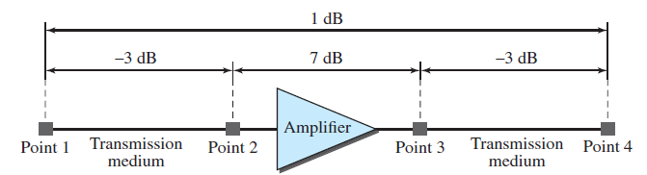
Examples
One reason that engineers use the decibel to measure the changes in the strength of a signal is that decibel numbers can be added (or subtracted) when we are measuring several points (cascading) instead of just two.
In this case, the decibel value can be calculated as
dB=-3+7-3= 1

Slide 41
SIGNAL IMPAIRMENT
Distortion
Distortion means that the signal changes its form or shape.
Distortion can occur in a composite signal made up of different frequencies.
Each signal component has its own propagation speed (see the next section) through a medium and, therefore, its own delay in arriving at the final destination.
Signal components at the receiver have phases different from what they had at the sender.

Slide 42
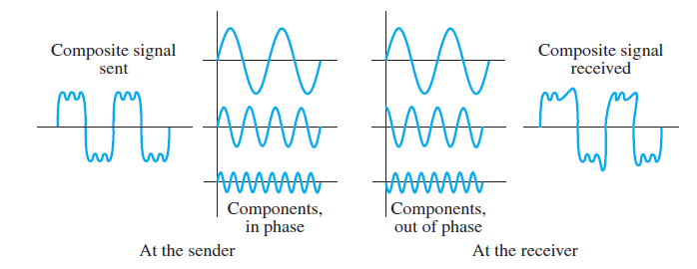
SIGNAL IMPAIRMENT

Slide 43
SIGNAL IMPAIRMENT
Noise
Noise is another cause of impairment.
Several type of noise such as thermal noise, induced noise, crosstalk, and impulse noise, may corrupt the signal.
Thermal noise is the random motion of electrons in a wire, which creates an extra signal not originally sent by the transmitter.
Induced noise comes from sources such as motors and appliances. These devices act as a sending antenna, and the transmission medium acts as the receiving antenna.

Slide 44
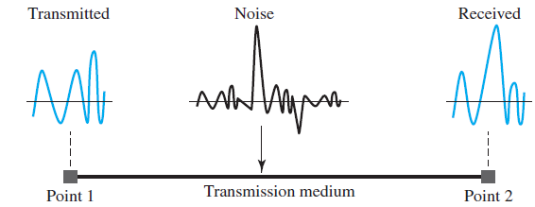
SIGNAL IMPAIRMENT
Crosstalk is the effect of one wire on the other. One wire acts as a
sending antenna and the other as the receiving antenna.
Impulse noise is a spike (a signal with high energy in a very short time) that comes from power lines, lightning, and so on.

Slide 45

Signal-to-Noise Ratio (SNR)
The signal-to-noise ratio is defined as
SNR is actually the ratio of what is wanted (signal) to what is not wanted (noise).
A high SNR means the signal is less corrupted by noise; a low SNR means the signal is more corrupted by noise.

Slide 46

Signal-to-Noise Ratio (SNR)
Because SNR is the ratio of two powers, it is often described in decibel units, SNRdB, defined as

Slide 47
Examples
The power of a signal is 10 mW and the power of the noise is 1 μW; what are the values of SNR and SNRdB?
The values of SNR and SNRdB for a noiseless channel are

Slide 48
Data Rate Limits
A very important consideration in data communications is how fast we can send data, in bits per second, over a channel
Data rate depends on three factors:
The bandwidth available
The level of the signals we use
The quality of the channel (the level of noise)

Slide 49
Data Rate Limits
Two theoretical formulas were developed to calculate the data rate: one by Nyquist for a noiseless channel, another by Shannon for a noisy channel.
Noiseless Channel: Nyquist Bit Rate
For a noiseless channel, the Nyquist bit rate formula defines the theoretical maximum bit rate
BitRate = 2 X bandwidth X log₂L
bandwidth is the bandwidth of the channel, L is the number of signal levels used to represent data, and BitRate is the bit rate in bits per second.

Slide 50
Noiseless Channel: Nyquist Bit Rate
According to the formula, we might think that, given a specific bandwidth, we can have any bit rate we want by increasing the number of signal levels. Although the idea is theoretically correct, practically there is a limit.
When we increase the number of signal levels, we impose a burden on the receiver.
If the number of levels in a signal is just 2, the receiver can easily distinguish between a 0 and a 1.

Slide 51
Noiseless Channel: Nyquist Bit Rate
If the level of a signal is 64, the receiver must be very sophisticated to distinguish between 64 different levels.
In other words, increasing the levels of a signal reduces the reliability of the system.
Consider a noiseless channel with a bandwidth of 3000 Hz transmitting a signal with two signal levels. The maximum bit rate can be calculated as
BitRate = 2 X 3000 X log₂2= 6000 bps

Slide 52
Noisy Channel: Shannon Capacity
In reality, we cannot have a noiseless channel; the channel is always noisy.
In 1944, Claude Shannon introduced a formula, called the Shannon capacity, to determine the theoretical highest data rate for a noisy channel:
Capacity = bandwidth X log₂(1 +SNR)
In this formula, bandwidth is the bandwidth of the channel, SNR is the signal-to-noise ratio, and capacity is the capacity of the channel in bits per second.

Slide 53
Noisy Channel: Shannon Capacity
In the Shannon formula there is no indication of the signal level, which means that no matter how many levels we have, we cannot achieve a data rate higher than the capacity of the channel.
In other words, the formula defines a characteristic of the channel, not the method of transmission.

Slide 54
Noisy Channel: Shannon Capacity-Examples
Consider an extremely noisy channel in which the value of the signal-to-noise ratio is almost zero. For this channel the capacity C is calculated as
C =B log₂ (1 +SNR) = B log₂ (1 + 0)= B log₂ 1 =B X 0=0
A telephone line normally has a bandwidth of 3000 Hz (300 to 3300 Hz) assigned for data communications. The signal-to-noise ratio is usually 3162. Calculate the channel capacity.

Slide 55
Using Both Limits
In practice, we need to use both methods to find the limits and signal levels
Example
We have a channel with a 1-MHz bandwidth. The SNR for this channel is 63. What are the appropriate bit rate and signal level?.
First, we use the Shannon formula to find the upper limit.

Slide 56
Using Both Limits
The Shannon formula gives us 6 Mbps, the upper limit.
For better performance we choose something lower, 4 Mbps, for example.
Then we use the Nyquist formula to find the number of signal levels.

Slide 57
Performance
Bandwidth
Throughput
Latency (Delay)
Bandwidth-Delay Product
Jitter

Slide 58
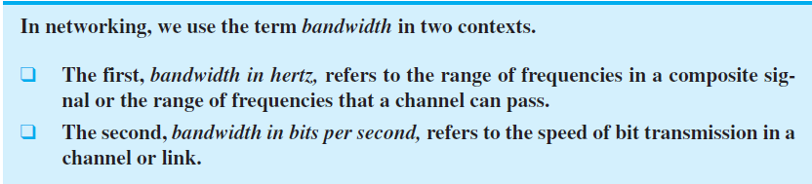
Performance
Up to now, we have discussed the tools of transmitting data (signals) over a network and how the data behave.
One important issue in networking is the performance of the network—how good is it?
Bandwidth
One characteristic that measure network performance is bandwidth.

Slide 59
Performance
Example:- The bandwidth of a subscriber line is 4 kHz for voice or data. The bandwidth of this line for data transmission can be up to 56 kbps, using a sophisticated modem to change the digital signal to analog.
If the telephone company improves the quality of the line and increases the bandwidth to 8 kHz, we can send 112 kbps.
For example, one can say that the bandwidth of a fast Ethernet network is 100 Mbps. This means we can send 100 Mbps through this network.

Slide 60
Performance
Throughput:
The throughput is the measure of how fast we can actually send data through a network.
A link may have a bandwidth of B bps, but we can only send T bps through this link with T always less than B.
In other words, the bandwidth is a potential measurement of a link; the throughput is an actual measurement of how fast we can send data.

Slide 61
Throughput
For example, we may have a link with a bandwidth of 1 Mbps, but the devices connected to the end of the link may handle only 200 kbps.
This means that we cannot send more than 200 kbps through this link.

Slide 62
Throughput- Example
A network with bandwidth of 10 Mbps can pass only an average of 12,000 frames per minute with each frame carrying an average of 10,000 bits. What is the throughput of this network?
We can calculate the throughput as
Throughput = (12,000 X 10,000) / 60 = 2 Mbps

Slide 63
Performance
Latency (Delay):
The latency or delay defines how long it takes for an entire message to completely arrive at the destination from the time the first bit is sent out from the source.
It is made up of four components: propagation time, transmission time, queuing time, and processing delay.
The latency or total delay is
Latency = propagation time + transmission time + queuing time + processing delay

Slide 64
Latency (Delay)
Propagation Time
measures the time required for a bit to travel from the source to the destination.
The propagation time is calculated by dividing the distance by the propagation speed.
Propagation time = Distance / (Propagation Speed)

Slide 65
Propagation Time
What is the propagation time if the distance between the two points is 12,000 km? Assume the propagation speed to be 2.4 × 10⁸ m/s in cable.
We can calculate the propagation time as
Propagation time = (12,000 X 1000) / (2.4 X 10⁸) = 50 ms
The example shows that a bit can go over the Atlantic Ocean in only 50 ms if there is a direct cable between the source and the destination.

Slide 66
Transmission Time
In data communications we don’t send just 1 bit, we send a message.
The first bit may take a time equal to the propagation time to reach its destination; the last bit also may take the same amount of time.
However, there is a time between the first bit leaving the sender and the last bit arriving at the receiver.
The first bit leaves earlier and arrives earlier; the last bit leaves later and arrives later.

Slide 67
Transmission Time
The transmission time of a message depends on the size of the message and the bandwidth of the channel.
Transmission time = (Message size) / Bandwidth
What are the propagation time and the transmission time for a 2.5-KB (kilobyte) message (an email) if the bandwidth of the network is 1 Gbps? Assume that the distance between the sender and the receiver is 12,000 km and that light travels at 2.4 × 10⁸ m/s.

Slide 68
Transmission Time
We can calculate the propagation and transmission time as
Propagation time =(12,000 X 1000) / (2.4 X 10⁸) = 50 ms
Transmission time =(2500 X 8) / 10⁹ = 0.02 ms
What are the propagation time and the transmission time for a 5-MB (megabyte) message (an image) if the bandwidth of the network is 1 Mbps? Assume that the distance between the sender and the receiver is 12,000 km and that light travels at 2.4 × 10⁸ m/s.

Slide 69
Queuing Time
It is the time needed for each intermediate or end device to hold the message before it can be processed.
The queuing time is not a fixed factor; it changes with the load imposed on the network.
When there is heavy traffic on the network, the queuing time increases.
An intermediate device, such as a router, queues the arrived messages and processes them one by one.
If there are many messages, each message will have to wait.

Slide 70
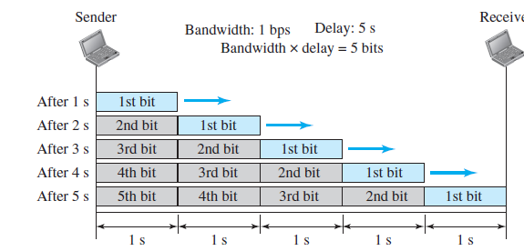
Performance
Bandwidth-Delay Product
Bandwidth and delay are two performance metric of a link.
However, what is very important in data communications is the product of the two, the bandwidth-delay product.
Case 1

Slide 71
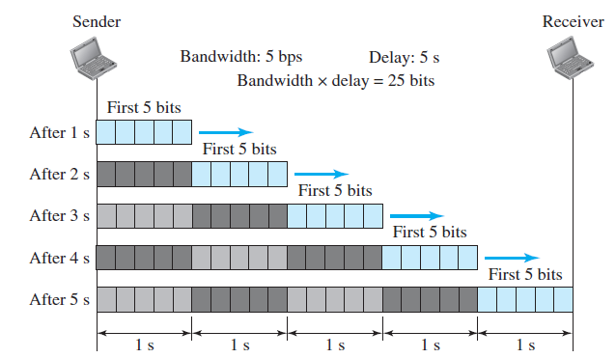
Bandwidth-Delay Product
Case 2
The bandwidth-delay product defines the number of bits that can fill the link.

Slide 72
Performance
Jitter
Another performance issue that is related to delay is jitter.
We can roughly say that jitter is a problem if different packets of data encounter different delays and the application using the data at the receiver site is time-sensitive (audio and video data, for example).
If the delay for the first packet is 20ms, for the second is 45ms, and for the third is 40ms, then the real-time application that uses the packets endures jitter.

Slide 73
DIGITAL TRANSMISSION
A computer network is designed to send information from one point to another.
This information needs to be converted to either a digital signal or an analog signal for transmission.

Slide 74
Digital-to-Digital Conversion
In this section, we see how we can represent digital data by using digital signals.
The conversion involves three techniques: line coding, block coding, and scrambling.
Line coding is always needed; block coding and scrambling may or may not be needed.

Slide 75
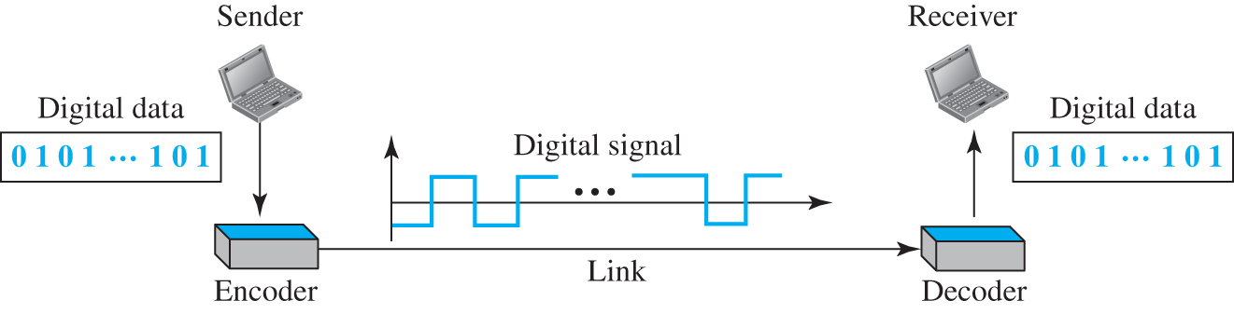
Line Coding
Line coding is the process of converting digital data to digital signals.
We assume that data, in the form of text, numbers, graphical images, audio, or video, are stored in computer memory as sequences of bits.
Notes:
Figure 2.8 Line coding and decoding A sender host device transforms digital data 0 1 0 1 ….1 0 1 continues to to an encoder. The encoder sends to the decoder through a link. The data appears as a digital signal in between the encoder and decoder. The decoder sends the same digital data to the receiver host device that equals 0 1 0 1….1 0 1.

Slide 76
Line Coding
Line coding converts a sequence of bits to a digital signal.
At the sender, digital data are encoded into a digital signal; at the receiver, the digital data are recreated by decoding the digital signal
Signal Element Versus Data Element
Let us distinguish between a data element and a signal element.
In data communications, our goal is to send data elements.
A data element is the smallest entity that can represent a piece of information: this is the bit.

Slide 77
Line Coding
In digital data communications, a signal element carries data elements.
A signal element is the shortest unit (timewise) of a digital signal.
In other words, data elements are what we need to send; signal elements are what we can send.
Data elements are being carried; signal elements are the carriers.
We define a ratio r which is the number of data elements carried by each signal element.
Figure (next slide) shows several situations with different values of r.

Slide 78
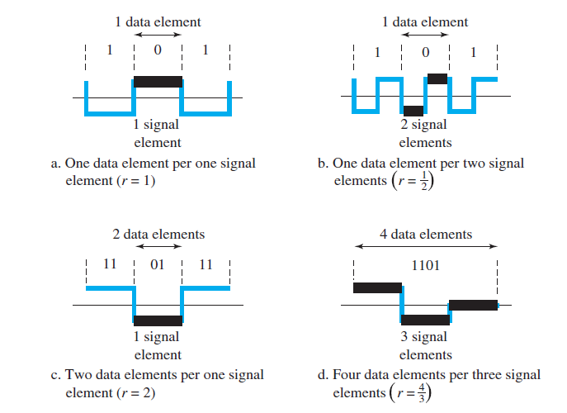
Line Coding

Slide 79
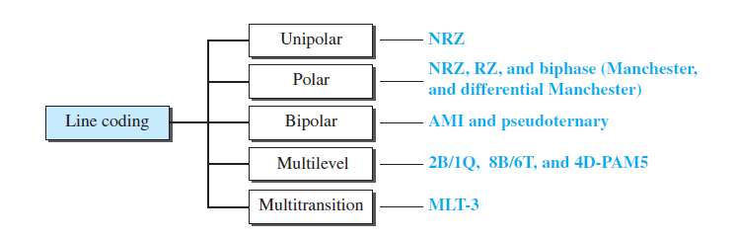
Line Coding Schemes
We can roughly divide line coding schemes into five broad categories

Slide 80
Unipolar Scheme
In a unipolar scheme, all the signal levels are on one side of the time axis, either above or below.
NRZ (Non-Return-to-Zero)
Traditionally, a unipolar scheme was designed as a non-return-to-zero (NRZ) scheme in which the positive voltage defines bit 1 and the zero voltage defines bit 0.
It is called NRZ because the signal does not return to zero at the middle of the bit.

Slide 81
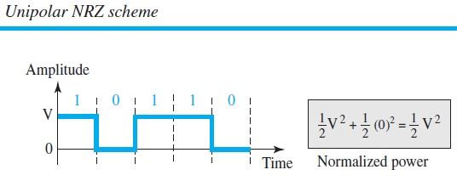
Unipolar Scheme

Slide 82
Unipolar Scheme
Compared with its polar counterpart (see the next section), this scheme is very costly.
As we will see shortly, the normalized power (the power needed to send 1 bit per unit line resistance) is double that for polar NRZ.
For this reason, this scheme is normally not used in data communications today.

Slide 83
Polar Schemes
In polar schemes, the voltages are on both sides of the time axis.
For example, the voltage level for 0 can be positive and the voltage level for 1 can be negative.
Non-Return-to-Zero (NRZ)
In polar NRZ encoding, we use two levels of voltage amplitude.
We can have two versions of polar NRZ: NRZ-L and NRZ-I, as shown in Figure (next slide).

Slide 84
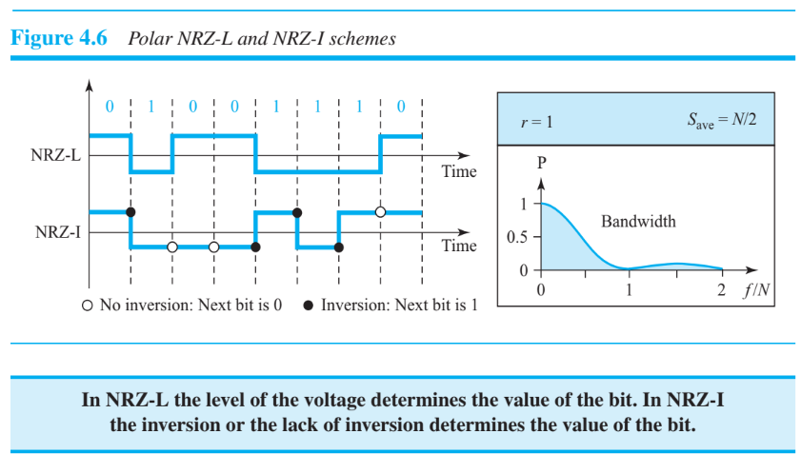
Polar Schemes

Slide 85
Polar Schemes
In the first variation, NRZ-L (NRZ-Level), the level of the voltage determines the value of the bit.
In the second variation, NRZ-I (NRZ-Invert), the change or lack of change in the level of the voltage determines the value of the bit.
If there is no change, the bit is 0; if there is a change, the bit is 1.

Slide 86
Comparison of NRZ-L and NRZ-I
Although baseline wandering is a problem for both variations, it is twice as severe in NRZ-L.
If there is a long sequence of 0s or 1s in NRZ-L, the average signal power becomes skewed.
The synchronization problem (sender and receiver clocks are not synchronized) also exists in both schemes.
Again, this problem is more serious in NRZ-L than in NRZ-I.

Slide 87
Return-to-Zero (RZ)
The main problem with NRZ encoding occurs when the sender and receiver clocks are not synchronized.
The receiver does not know when one bit has ended and the next bit is starting.
One solution is the return-to-zero (RZ) scheme, which uses three values: positive, negative, and zero.
In RZ, the signal changes not between bits but during the bit.

Slide 88
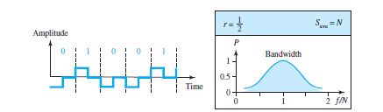
Return-to-Zero (RZ)
The main disadvantage of RZ encoding is that it requires two signal changes to encode a bit and therefore occupies greater bandwidth.
Another problem is the complexity: RZ uses three levels of voltage, which is more complex to create and discern.

Slide 89
Biphase: Manchester and Differential Manchester
The idea of RZ (transition at the middle of the bit) and the idea of NRZ-L are combined into the Manchester scheme.
In Manchester encoding, the duration of the bit is divided into two halves.
The voltage remains at one level during the first half and moves to the other level in the second half.
The transition at the middle of the bit provides synchronization.

Slide 90
Biphase: Manchester and Differential Manchester
Differential Manchester, on the other hand, combines the ideas of RZ and NRZ-I.
There is always a transition at the middle of the bit, but the bit values are determined at the beginning of the bit.
If the next bit is 0, there is a transition; if the next bit is 1, there is none.
Figure (next slide) shows both Manchester and differential Manchester encoding.

Slide 91
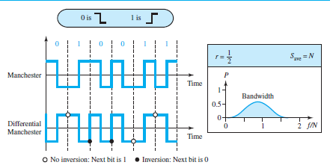
Biphase: Manchester and Differential Manchester

Slide 92
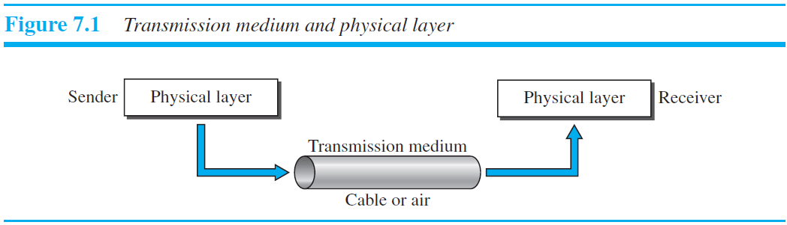
Transmission Media
Transmission media are actually located below the physical layer and are directly controlled by the physical layer.
We could say that transmission media belong to layer zero.
Figure shows the position of transmission media in relation to the physical layer.

Slide 93
Transmission Media
A transmission medium can be broadly defined as anything that can carry information from a source to a destination.
For example, the transmission medium for two people having a dinner conversation is the air.
For a written message, the transmission medium might be a mail carrier, a truck, or an airplane.
In data communications the definition of the information and the transmission medium is more specific.
The transmission medium is usually free space, metallic cable, or fiber-optic cable.
The information is usually a signal that is the result of a conversion of data from another form.

Slide 94
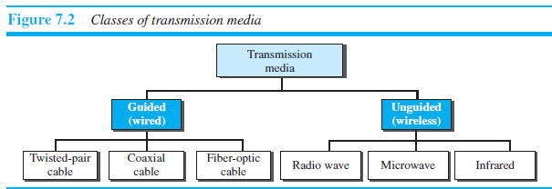
Transmission Media
In telecommunications, transmission media can be divided into two broad categories: guided and unguided.
Guided media include twisted-pair cable, coaxial cable, and fiber-optic cable.
Unguided medium is free space.

Slide 95
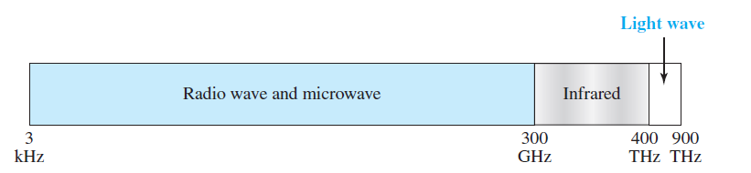
Unguided Media: Wireless
Unguided medium transport electromagnetic waves without using a physical conductor.
This type of communication is often referred to as wireless communication.
Signals are normally broadcast through free space and thus are available to anyone who has a device capable of receiving them.

Slide 96
Guided Media
Guided media, which are those that provide a conduit from one device to another, include twisted-pair cable, coaxial cable, and fiber-optic cable.
A signal traveling along any of these media is directed and contained by the physical limits of the medium.
Twisted-pair and coaxial cable use metallic (copper) conductors that accept and transport signals in the form of electric.
A fiber-optic cable is made of glass or plastic and transmits signals in the form of light.

Slide 97
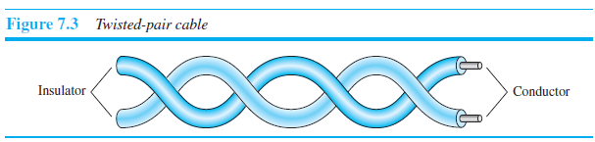
Guided Media
1. Twisted-Pair Cable
A twisted pair consists of two conductors (normally copper), each with its own plastic insulation, twisted together.
One of the wires is used to carry signals to the receiver, and the other is used only
as a ground reference.
The receiver uses the difference between the two.
In addition to the signal sent by the sender on one of the wires, interference (noise)
and crosstalk may affect both wires and create unwanted signals.

Slide 98
Guided Media
If the two wires are parallel, the effect of these unwanted signals is not the same in both wires because they are at different locations relative to the noise or crosstalk sources (e.g., one is closer and the other is farther). This results in a difference at the receiver.
By twisting the pairs, a balance is maintained. For example, suppose in one twist, one wire is closer to the noise source and the other is farther; in the next twist, the reverse is true. Twisting makes it probable that both wires are equally affected by external influences (noise or crosstalk).
Unshielded Versus Shielded Twisted-Pair Cable:
The most common twisted-pair cable used in communications is referred to as unshielded twisted-pair (UTP). IBM has also produced a version of twisted-pair cable for its use, called shielded twisted-pair (STP).
STP cable has a metal foil or braided mesh covering that encases each pair of insulated conductors. Although metal casing improves the quality of cable by preventing the penetration of noise or crosstalk, it is bulkier and more expensive.

Slide 99
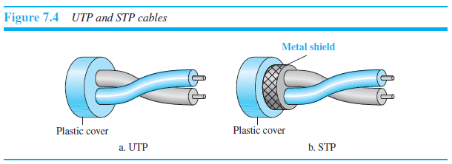
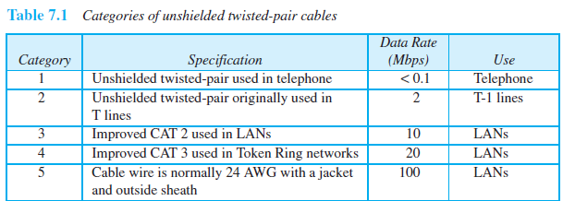
Guided Media

Slide 100
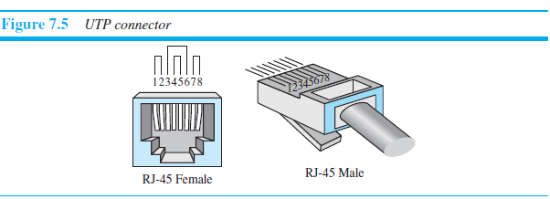
Guided Media
Connectors
The most common UTP connector is RJ45 (RJ stands for registered jack), as shown in Figure.
The RJ45 is a keyed connector, meaning the connector can be inserted in only one way.

Slide 101
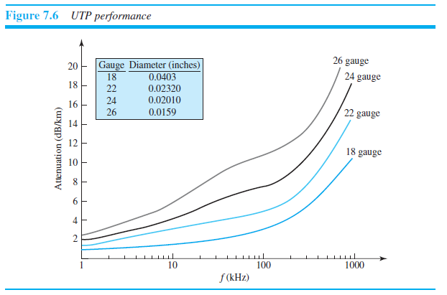
Guided Media
Figure 7.6 shows that with increasing frequency, the attenuation, measured in
decibels per kilometer (dB/km), sharply increases with frequencies above 100 kHz. Note
that gauge is a measure of the thickness of the wire.

Slide 102
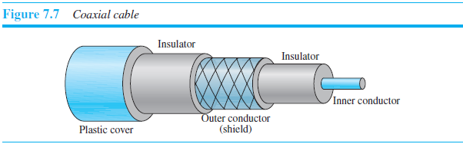
Guided Media
2. Coaxial Cable
Coaxial cable (or coax) carries signals of higher frequency ranges than those in twisted pair cable, in part because the two media are constructed quite differently.
Instead of having two wires, coax has a central core conductor of solid or stranded wire (usually copper) enclosed in an insulating sheath, which is, in turn, encased in an outer conductor of metal foil, braid, or a combination of the two.
The outer metallic wrapping serves both as a shield against noise and as the second conductor, which completes the circuit.
This outer conductor is also enclosed in an insulating sheath, and the whole cable is protected by a plastic cover.

Slide 103
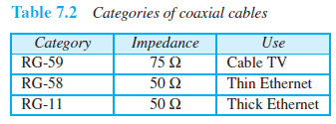
Guided Media
Coaxial Cable Standards
Coaxial cables are categorized by their Radio Government (RG) ratings.
Each RG number denotes a unique set of physical specifications, including the wire gauge of the inner conductor, the thickness and type of the inner insulator, the construction of the shield, and the size and type of the outer casing.
Each cable defined by an RG rating is adapted for a specialized function, as shown in Table 7.2.

Slide 104
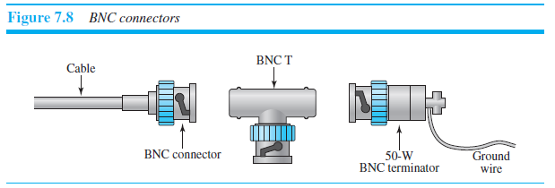
Guided Media
Coaxial Cable Connectors
To connect coaxial cable to devices, we need coaxial connectors.
The most common type of connector used today is the Bayonet Neill-Concelman (BNC) connector.
Figure shows three popular types of these connectors: the BNC connector, the BNC T connector, and the BNC terminator.

Slide 105
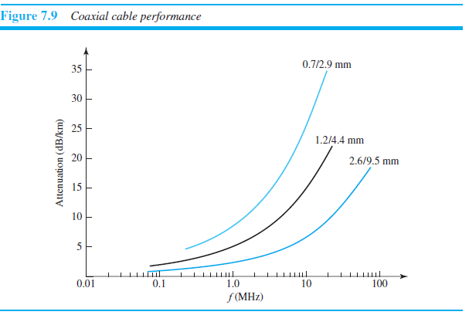
Guided Media
Performance
As we did with twisted-pair cable, we can measure the performance of a coaxial cable.
The attenuation is much higher in coaxial cable than in twisted-pair cable.
In other words, although coaxial cable has a much higher bandwidth, the signal weakens rapidly and requires the frequent use of repeaters.

Slide 106
Guided Media
3. Fiber-Optic Cable
A fiber-optic cable is made of glass or plastic and transmits signals in the form of light.
Optical fibers use reflection to guide light through a channel.
A glass or plastic core is surrounded by a cladding of less dense glass or plastic.
The difference in density of the two materials must be such that a beam of light moving through the core is reflected off the cladding instead of being refracted into it.

Slide 107
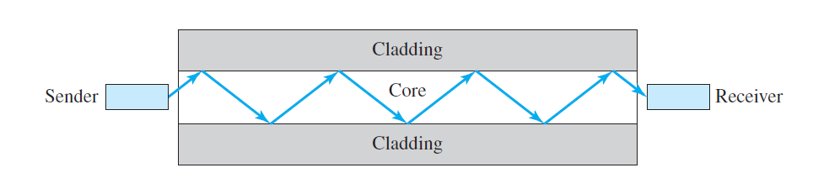
Guided Media
Optical Fiber

Slide 108
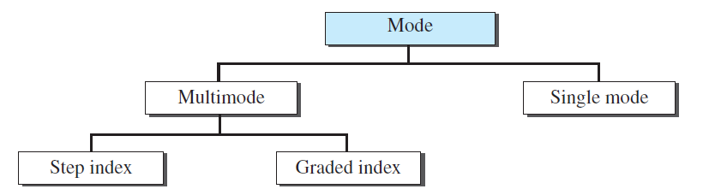
Guided Media
Propagation Modes
In multimode step-index fiber, the density of the core remains constant from the center to the edges.
In multimode graded-index fiber, Density is highest at the center of the core and decreases gradually to its lowest at the edge.
The single-mode fiber itself is manufactured with a much smaller diameter than that of multimode fiber, and with substantially lower density (index of refraction).

Slide 109
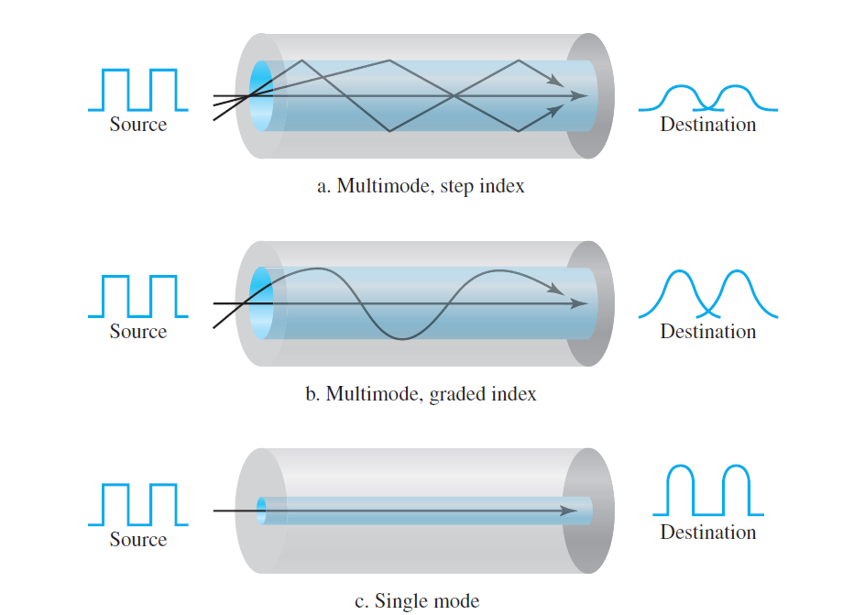
Propagation Modes

Slide 110
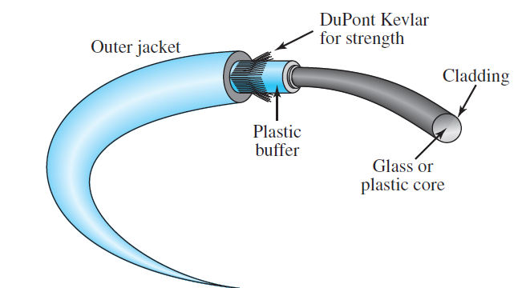
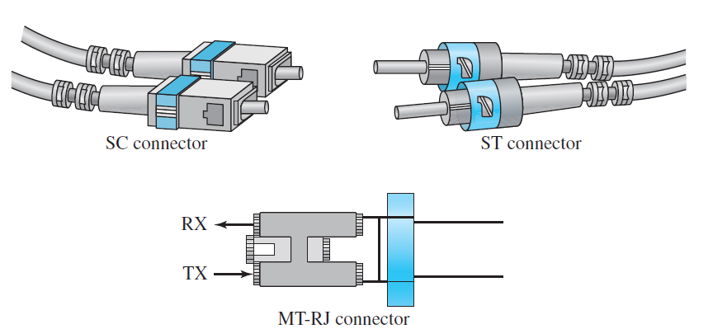
Guided Media
Fiber construction
Fiber-optic cable connectors
Subscriber Channel (SC)
Straight-Tip (ST)
MT-RJ

Slide 111
Advantages of Optical Fiber
Higher bandwidth. Fiber-optic cable can support dramatically higher bandwidths than either twisted-pair or coaxial cable.
Less signal attenuation. Fiber-optic transmission distance is significantly greater than that of other guided media. A signal can run for 50 km without requiring regeneration. We need repeaters every 5 km for coaxial or twisted-pair cable.
Immunity to electromagnetic interference. Electromagnetic noise cannot affect fiber-optic cables.
Resistance to corrosive materials. Glass is more resistant to corrosive materials than copper.
Light weight. Fiber-optic cables are much lighter than copper cables.
Greater immunity to tapping. Fiber-optic cables are more immune to tapping than copper cables. Copper cables create antenna effects that can easily be tapped.

Slide 112
Disadvantages of Optical Fiber
Installation and maintenance. Fiber-optic cable is a relatively new technology. Its installation and maintenance require expertise that is not yet available everywhere.
Unidirectional light propagation. Propagation of light is unidirectional. If we
need bidirectional communication, two fibers are needed.
Cost. The cable and the interfaces are relatively more expensive than those of other guided media. If the demand for bandwidth is not high, often the use of optical fiber cannot be justified.

Slide 113
Switching
Introduction
A network is a set of connected devices. Whenever we have multiple devices, we have the problem of how to connect them to make one-to-one communication possible.
One solution is to make a point-to-point connection between each pair of devices (a mesh topology) or between a central device and every other device (a star topology). These methods, however, are impractical and wasteful when applied to very large networks.
A better solution is switching. A switched network consists of a series of interlinked nodes, called switches. Switches are devices capable of creating temporary connections between two or more devices linked to the switch.

Slide 114
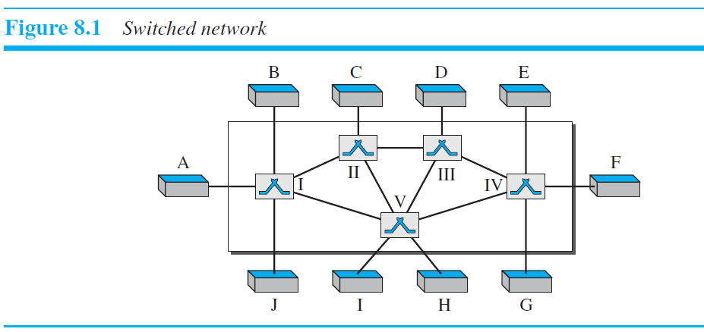
Switching
The end systems (communicating devices) are labeled A, B, C, D, and so on, and the switches are labeled I, II, III, IV, and V. Each switch is connected to multiple links.

Slide 115
Packet Switching
In data communications, we need to send messages from one end system to another. If the message is going to pass through a packet-switched network, it needs to be divided into packets of fixed or variable size. The size of the packet is determined by the network and the governing protocol.
In packet switching, there is no resource allocation for a packet. This means that there is no reserved bandwidth on the links, and there is no scheduled processing time for each packet.
Resources are allocated on demand. The allocation is done on a first come, first-served basis. When a switch receives a packet, no matter what the source or destination is, the packet must wait if there are other packets being processed.
We can have two types of packet-switched networks:
datagram networks and
virtual circuit networks.

Slide 116
Packet Switching
Datagram Networks
In a datagram network, each packet is treated independently of all others. Even if a packet is part of a multipacket transmission, the network treats it as though it existed alone. Packets in this approach are referred to as datagrams.

Slide 117
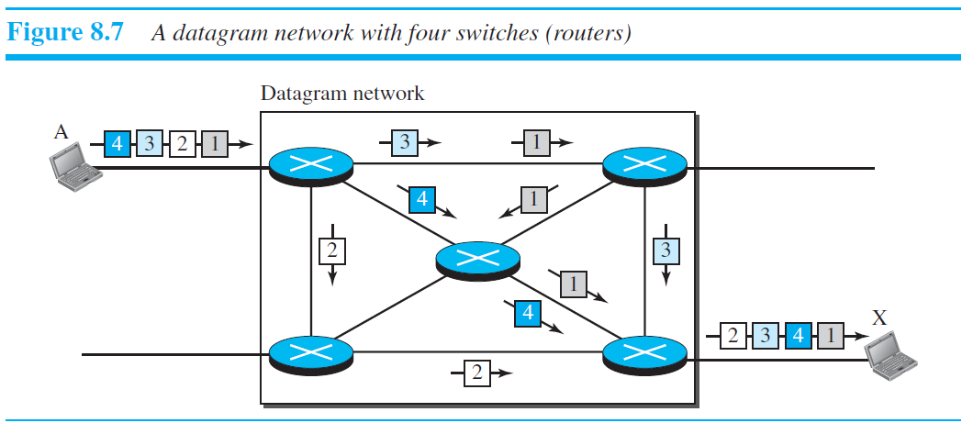
Packet Switching
Figure 8.7 shows how the datagram approach is used to deliver four packets from station A to station X. The switches in a datagram network are traditionally referred to
as routers.

Slide 118
Packet Switching
In this example, all four packets (or datagrams) belong to the same message, but may travel different paths to reach their destination.
This is so because the links may be involved in carrying packets from other sources and do not have the necessary bandwidth available to carry all the packets from A to X.
The datagram networks are sometimes referred to as connectionless networks. The term connectionless here means that the switch (packet switch) does not keep information about the connection state.
There are no setup or teardown phases. Each packet is treated the same by a switch regardless of its source or destination.

Slide 119
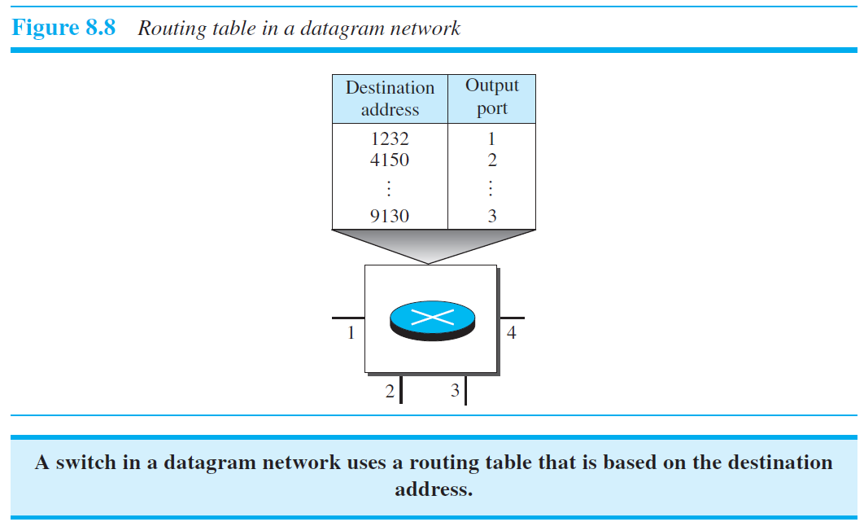
Packet Switching

Slide 120
Packet Switching
Destination Address
Every packet in a datagram network carries a header that contains, among other information, the destination address of the packet. When the switch receives the packet, this destination address is examined; the routing table is consulted to find the corresponding port through which the packet should be forwarded.
Efficiency
The efficiency of a datagram network is better than that of a circuit-switched network; resources are allocated only when there are packets to be transferred. If a source sends a packet and there is a delay of a few minutes before another packet can be sent, the resources can be reallocated during these minutes for other packets from other sources.

Slide 121
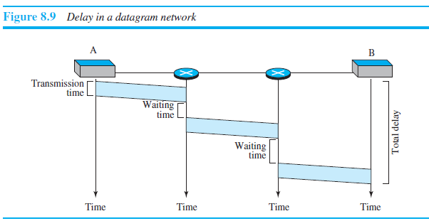
Packet Switching
Delay
There may be greater delay in a datagram network than in a virtual-circuit network. Although there are no setup and teardown phases, each packet may experience a wait at a switch before it is forwarded. In addition, since not all packets in a message necessarily travel through the same switches, the delay is not uniform for the packets of a message. Figure 8.9 gives an example of delay in a datagram network for one packet.

Slide 122
Packet Switching
Virtual-Circuit Networks
A virtual-circuit network is a cross between a circuit-switched network and a datagram network. It has some characteristics of both.
As in a circuit-switched network, there are setup and teardown phases in addition
to the data transfer phase.
Resources can be allocated during the setup phase, as in a circuit-switched network,
or on demand, as in a datagram network.
As in a datagram network, data are packetized and each packet carries an address in the header. However, the address in the header has local jurisdiction (it defines what the next switch should be and the channel on which the packet is being carried), not end-to-end jurisdiction. The reader may ask how the intermediate switches know where to send the packet if there is no final destination address carried by a packet. The answer will be clear when we discuss virtual-circuit identifiers in the next section.

Slide 123

Packet Switching
As in a circuit-switched network, all packets follow the same path established during
the connection.
A virtual-circuit network is normally implemented in the data-link layer, while a circuit-switched network is implemented in the physical layer and a datagram network in the network layer. But this may change in the future.
Figure 8.10 is an example of a virtual-circuit network.

Slide 124
Packet Switching
Addressing
In a virtual-circuit network, two types of addressing are involved: global and local
(virtual-circuit identifier).
Global Addressing
A source or a destination needs to have a global address—an address that can be unique in the scope of the network or internationally if the network is part of an international network. However, we will see that a global address in virtual-circuit networks is used only to create a virtual-circuit identifier, as discussed next.

Slide 125
Packet Switching
Three Phases
As in a circuit-switched network, a source and destination need to go through three
phases in a virtual-circuit network: setup, data transfer, and teardown.
In the setup phase, the source and destination use their global addresses to help switches make table entries for the connection.
In the teardown phase, the source and destination inform the switches to delete the corresponding entry.

Slide 126

Packet Switching

Slide 127

Packet Switching
Data-Transfer Phase
To transfer a frame from a source to its destination, all switches need to have a table entry for this virtual circuit. The table, in its simplest form, has four columns. This means that the switch holds four pieces of information for each virtual circuit that is already set up.

Slide 128

Packet Switching
Setup Phase
In the setup phase, a switch creates an entry for a virtual circuit. For example, suppose
source A needs to create a virtual circuit to B. Two steps are required: the setup request
and the acknowledgment.

Slide 129
Packet Switching
a. Source A sends a setup frame to switch 1.
b. Switch 1 receives the setup request frame. It knows that a frame going from A to B
goes out through port 3. How the switch has obtained this information is a point covered in future chapters. The switch, in the setup phase, acts as a packet switch; it has a routing table which is different from the switching table. For the moment, assume that it knows the output port. The switch creates an entry in its table for this virtual circuit, but it is only able to fill three of the four columns. The switch assigns the incoming port (1) and chooses an available incoming VCI (14) and the outgoing port (3). It does not yet know the outgoing VCI, which will be found during the acknowledgment step. The switch then forwards the frame through port 3 to switch 2.
c. Switch 2 receives the setup request frame. The same events happen here as at switch 1; three columns of the table are completed: in this case, incoming port (1), incoming VCI (66), and outgoing port (2).
d. Switch 3 receives the setup request frame. Again, three columns are completed: incoming port (2), incoming VCI (22), and outgoing port (3).

Slide 130
Packet Switching
e. Destination B receives the setup frame, and if it is ready to receive frames from A, it assigns a VCI to the incoming frames that come from A, in this case 77. This VCI lets the destination know that the frames come from A, and not other sources.

Slide 131
Packet Switching
Acknowledgment
A special frame, called the acknowledgment frame, completes the entries in the switching
tables. Figure 8.15 shows the process.
a. The destination sends an acknowledgment to switch 3. The acknowledgment carries
the global source and destination addresses so the switch knows which entry in the
table is to be completed. The frame also carries VCI 77, chosen by the destination as
the incoming VCI for frames from A. Switch 3 uses this VCI to complete the outgoing
VCI column for this entry. Note that 77 is the incoming VCI for destination B,
but the outgoing VCI for switch 3.
b. Switch 3 sends an acknowledgment to switch 2 that contains its incoming VCI in the
table, chosen in the previous step. Switch 2 uses this as the outgoing VCI in the table.

Slide 132

Packet Switching
c. Switch 2 sends an acknowledgment to switch 1 that contains its incoming VCI in the table, chosen in the previous step. Switch 1 uses this as the outgoing VCI in the table.
d. Finally switch 1 sends an acknowledgment to source A that contains its incoming VCI in the table, chosen in the previous step.
e. The source uses this as the outgoing VCI for the data frames to be sent to destination

Slide 133
Packet Switching
Teardown Phase
In this phase, source A, after sending all frames to B, sends a special frame called a
teardown request. Destination B responds with a teardown confirmation frame. All
switches delete the corresponding entry from their tables.
Efficiency
As we said before, resource reservation in a virtual-circuit network can be made during
the setup or can be on demand during the data-transfer phase. In the first case, the delay
for each packet is the same; in the second case, each packet may encounter different
delays. There is one big advantage in a virtual-circuit network even if resource allocation
is on demand. The source can check the availability of the resources, without actually
reserving it. Consider a family that wants to dine at a restaurant. Although the restaurant
may not accept reservations (allocation of the tables is on demand), the family can call
and find out the waiting time. This can save the family time and effort.

Slide 134
Packet Switching
Delay in Virtual-Circuit Networks
In a virtual-circuit network, there is a one-time delay for setup and a one-time delay for
teardown. If resources are allocated during the setup phase, there is no wait time for
individual packets. Figure shows the delay for a packet traveling through two
switches in a virtual-circuit network.

